Slide 2
T-DEV-600
Trelltech

Slide 3
What is an API ?

Slide 4
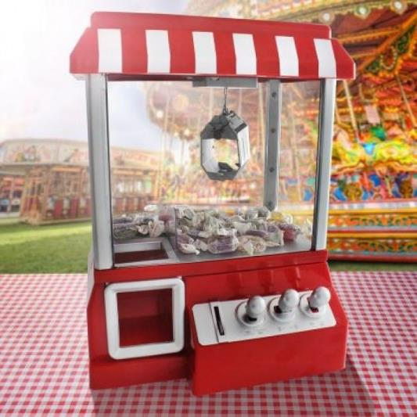
API
This machine uses an interface to retrieve resources.

Slide 5
API
A server also uses an interface to retrieve resources. This interface is called an Application Programming Interface.
This interface uses the HTTP protocol via URLs to obtain resources.
Server
URL as interface
Database

Slide 6
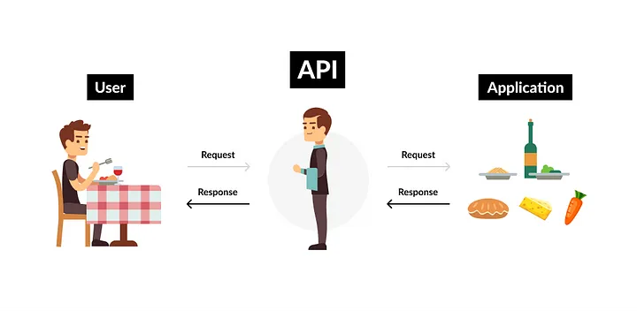
API
Another (very common) analogy is a restaurant: you tell the waiter what you want to order, and he brings back from the kitchen (backend) the food you ordered.

Slide 7
API
CRUD | Méthode | URL
Create | POST | /user
Read | GET | /user/{id}
Update | PUT | /user
Delete | DELETE | /user/{id}
But that's not all: it's also possible to create, read, update and delete a resource - this is called CRUD.

Slide 8
What about the project ?

Slide 9
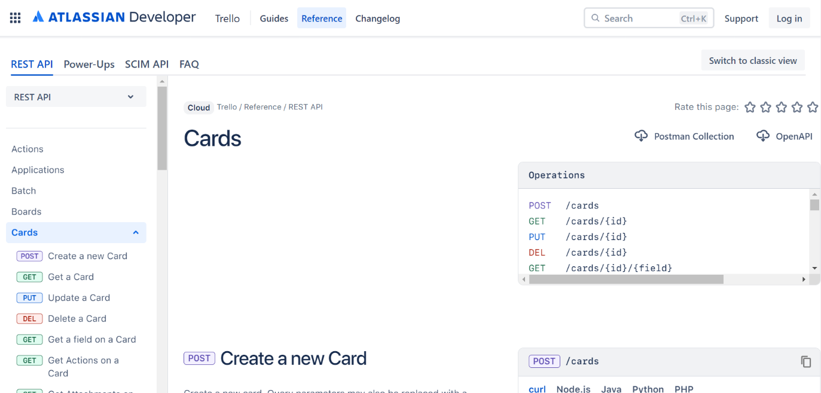
Project
You'll be using Trello's API.

Slide 10
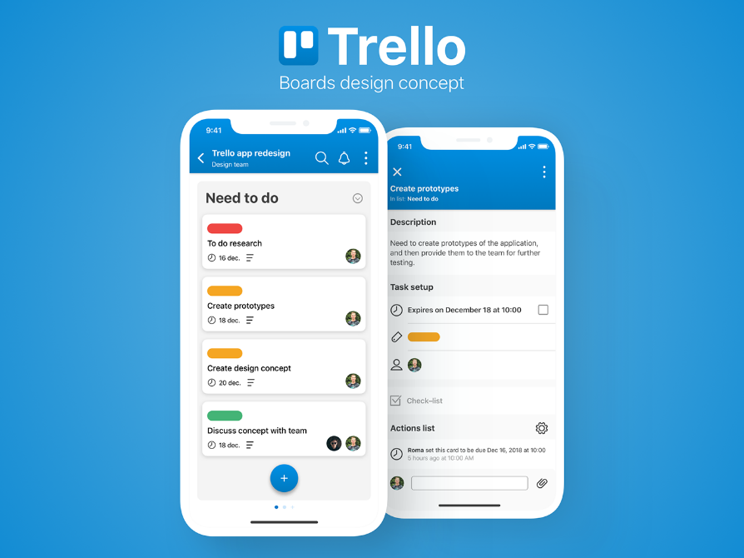
Project
You'll use this API to create a project management application.

Slide 11

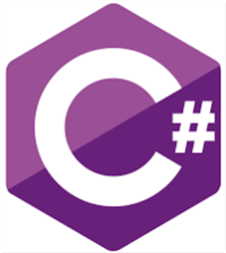

Technos

Slide 12
Tests
Your application needs to be tested to ensure development quality.

Slide 13
Documentation
Documents might be :
The documents should enable a newcomer to take charge of the project.
- an activity diagram
- a class diagram
- sequence diagram
- use cases
- etc.

Slide 14
